Slide 1
Enterprise Architecture Engineering (EAE) Architecture Community of Practice (ACOP)
March 30, 2020

Slide 2
Agenda
Introduction to the AEE COE’s COP
Highlighted Solution: Okta
Open discussion
Notes:
I started with a set of slides using my personal experience. It then dawned on me to infuse SAFe vernacular. By the time I was done, it was all SAFe

Slide 3
AEE COE’s Architecture COP
This COP is part of our overall strategy to align technical efforts across the organization.
Agile Architecture
Architecture Roadmap
Engagement and Collaboration
As with any COP, this is intended to facilitate collaboration
Share
Anyone can share. It could be a project in one part of the company, or information gathered by one team on a vendor
Share information on tools/technologies/vendors that are reviewed
Share successes and failures
Collaborate
Provide a Forum to raise up issues and discuss solutions
Provide a way to engage other organizations efficiently (Example, we could have infrastructure provide an overview on Nile or our Datacenter plans)
Provide a Forum to engage directly with teams you may never otherwise never talk to
We expect that COP members/attendees will take the information back to their teams.

Slide 4
Highlighted Solution: Okta
Highlevel
Progress
Specifics/How to get started
Notes:
I started with a set of slides using my personal experience. It then dawned on me to infuse SAFe vernacular. By the time I was done, it was all SAFe

Slide 5
OKTA and Identity Management at Cotiviti
OKTA Overview
Cotiviti needs for Initiative
Implementations at Cotiviti – Four in Progress
OKTA Development API Interfaces
OKTA UI Tour
OKTA Environments
Progress To Date: Documentation / Confluence / Agile Architecture Roadmap
Development Practices and Steps
QA and Next Steps
Appendix

Slide 6
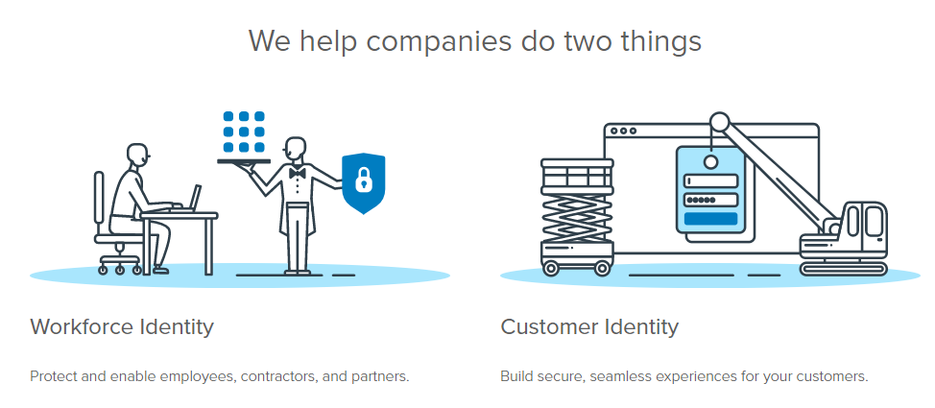

Cotiviti AEE CoP Identity Management
OKTA Overview
Okta is a cloud provider of Identity Management Services.
It enables SSO access to cloud, on premise, and mobile applications.
It’s for our own Users, Client’s Users, Partners, and Contractors
It provides access to thousands of applications using Prebuilt integrations.
Integration and APIs for On Premise Applications and Services

Slide 7
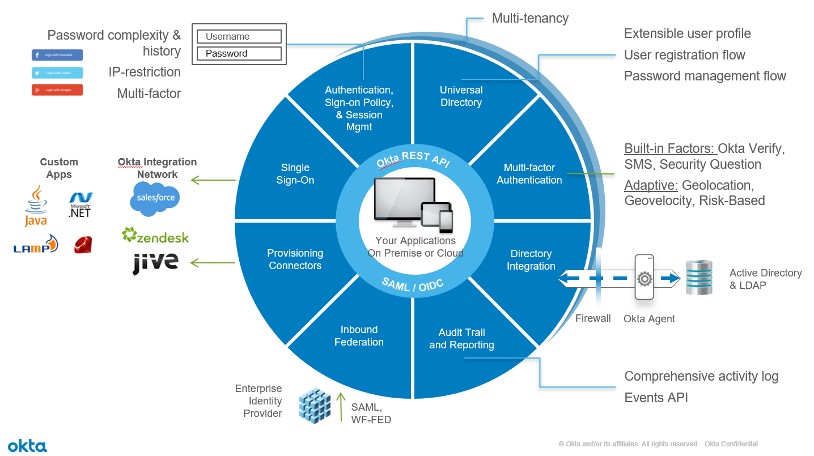
Cotiviti AEE CoP Identity Management

Slide 8
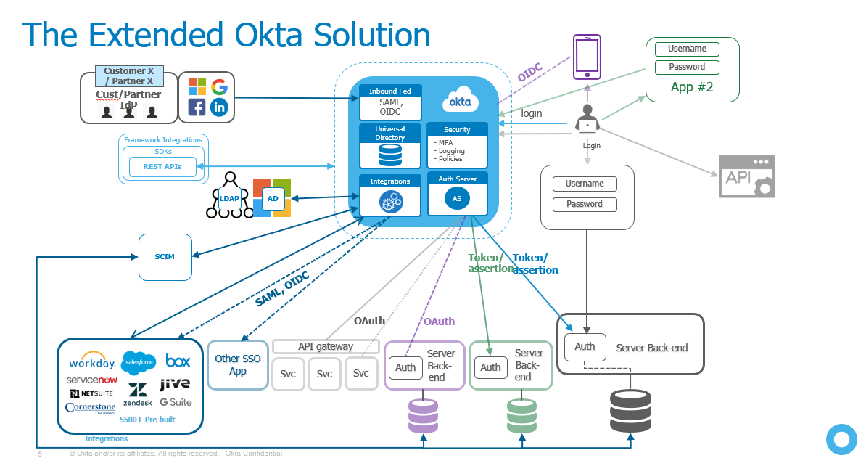
Cotiviti AEE CoP Identity Management

Slide 9
Cotiviti AEE CoP Identity Management
OKTA Overview
What does Cotiviti want to deliver from OKTA Integration?
Single Sign On Ability for Internal Users and External Client Users
Single Directories of all Employees, Application Users, and Client Users
Single Source to Onboard and Offboard
Authentication vrs Authorization: OKTA Authentication Current Scope
Increase Application Agility and Speed to working Code
Security and Consistency in approach. HITRUST / SOC2 / SOX
Build it once. Stop building custom code for User Identity.
Ability retire/refresh custom built systems for identity and SSO
MFA to meet Application Needs – Built In as needed.
MFA Features are extensive. Cotiviti application needs vary

Slide 10
Cotiviti AEE CoP Identity Management
Cotiviti OKTA Application Initiative
Cotiviti Applications
Nucleus
Risk Adjustment
RMI
Cotiviti R&D
AEE Architects
R&D Teams Vinay, Kyle, Stephen, Karishma, Rabin, Bikalba, Alex K
UST Partners Alex J, more..
Cotiviti Workforce
Infrastructure Team Raj Thakuri, Darryl Defendorf, Scott Milbury
Domain Consolidation/Bridge
Cotiviti.com ccaintranet domains
Ultipro Integration
OKTA Professional Services
Architecture and Engineering
Design Artifacts

Slide 11
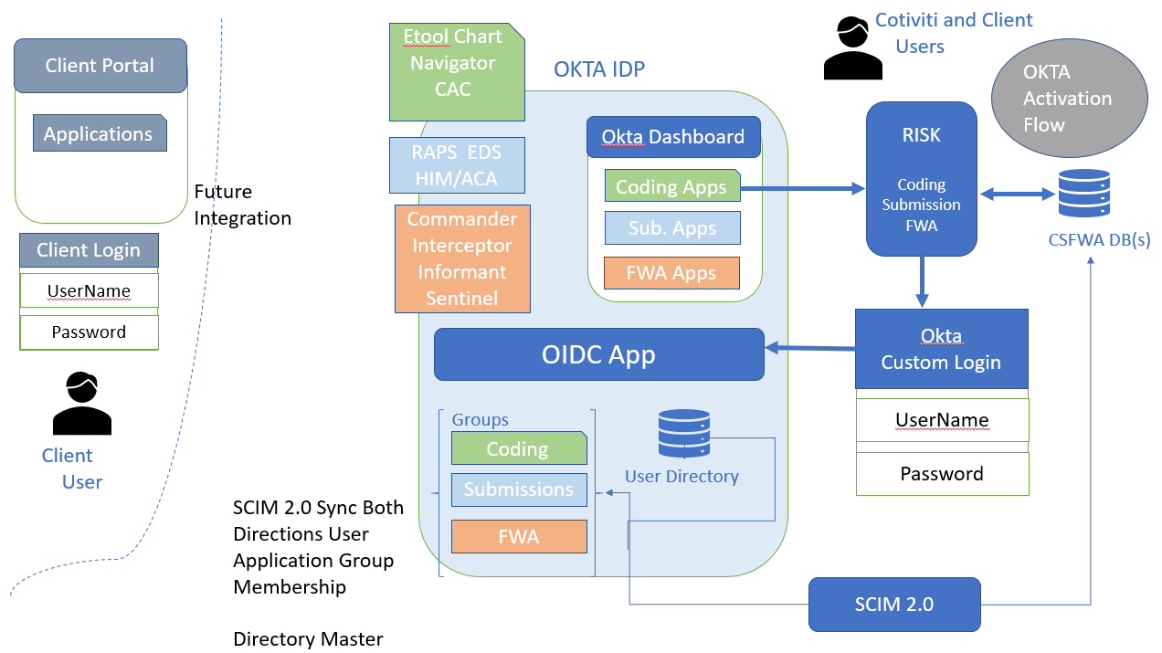
Cotiviti AEE CoP Identity Management
OKTA Cotiviti Application Integration RISK Adjustment
REVENUE

Slide 12
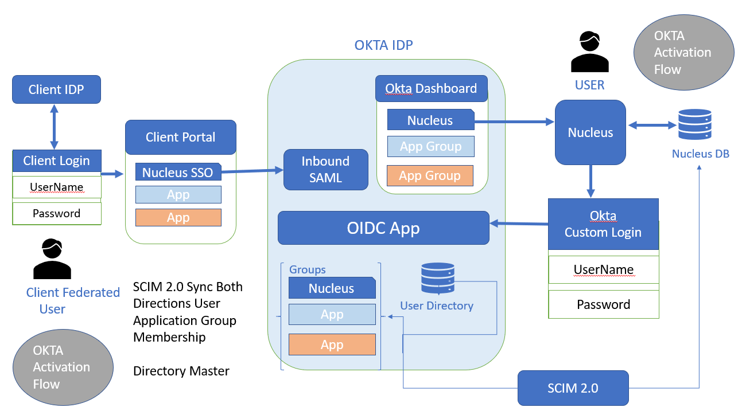
Cotiviti AEE CoP Identity Management
OKTA Cotiviti Application Integration Nucleus
PAYMENT ACCURACY

Slide 13
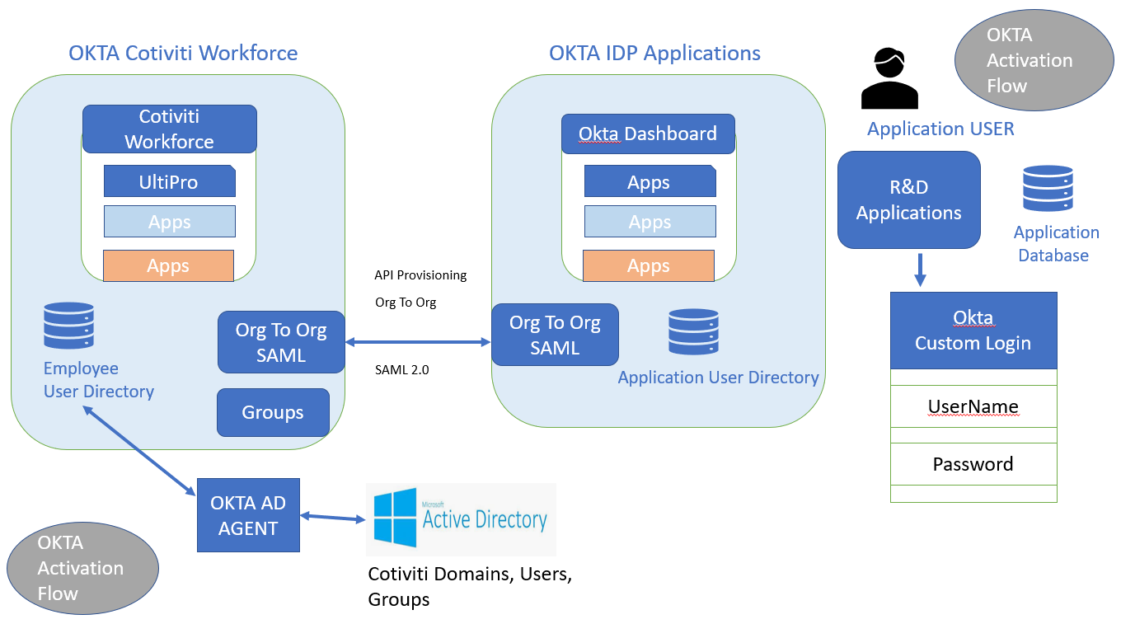
Cotiviti AEE CoP Identity Management
OKTA Cotiviti Workforce

Slide 14
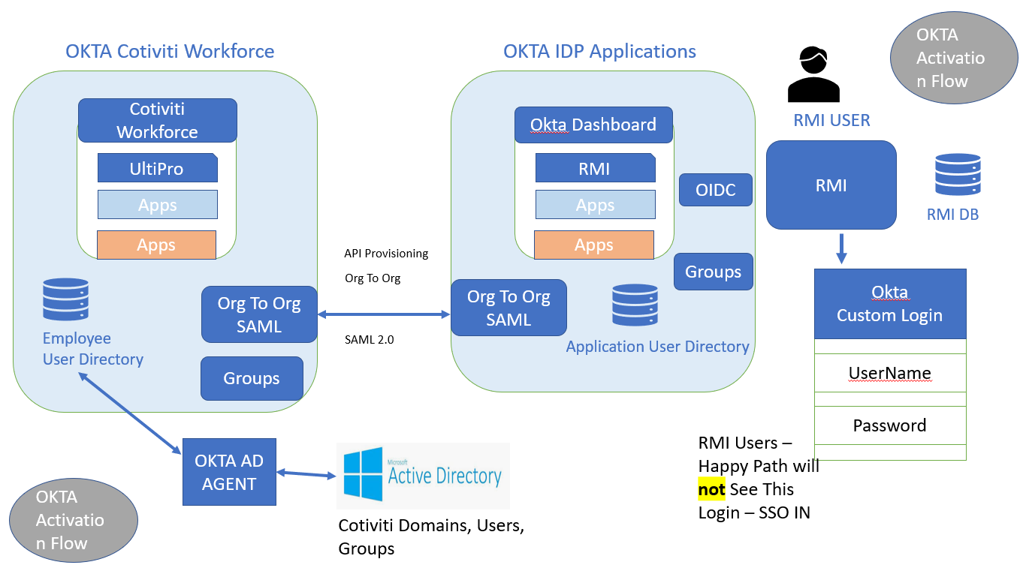
Cotiviti AEE CoP Identity Management
OKTA Cotiviti Application Integration RMI
PAYMENT PCA

Slide 15
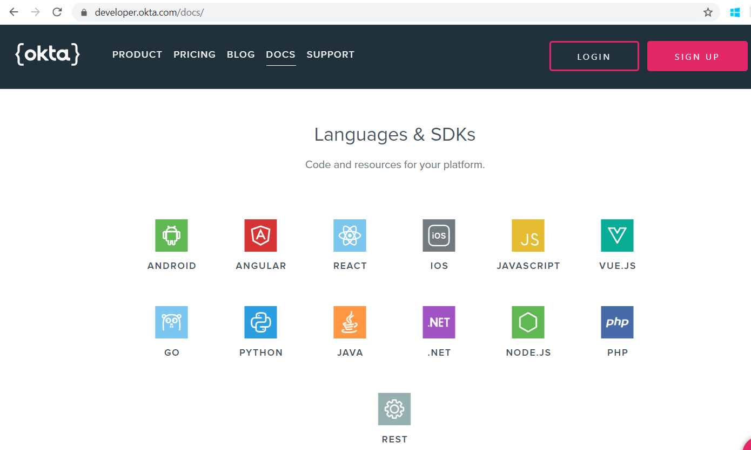
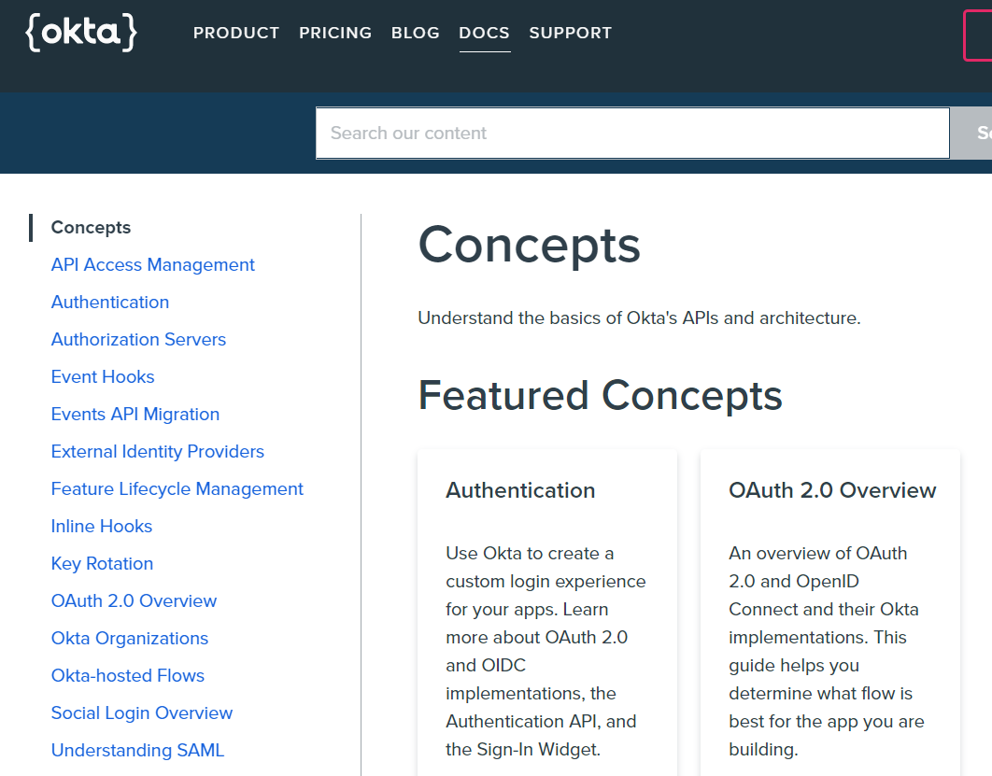
Cotiviti AEE CoP Identity Management
OKTA Development API Interfaces

Slide 16
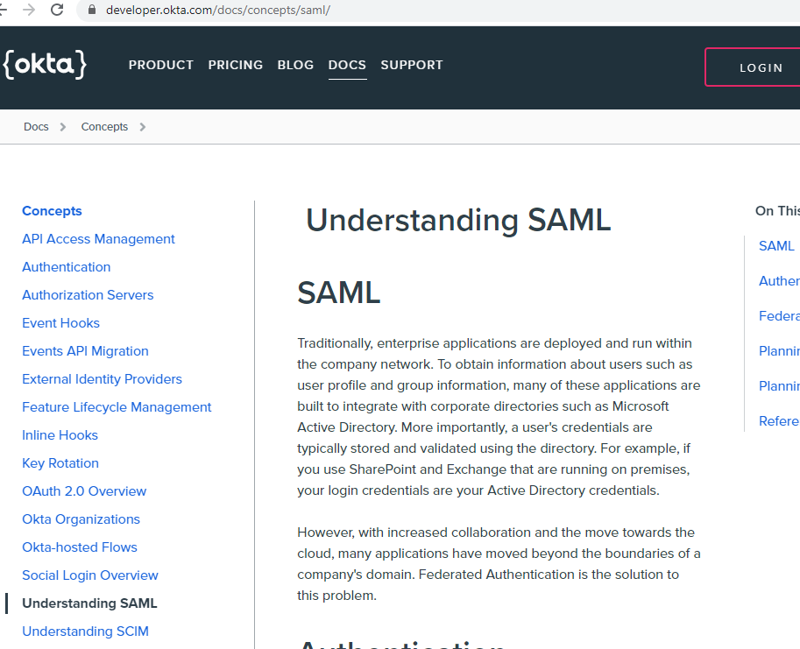
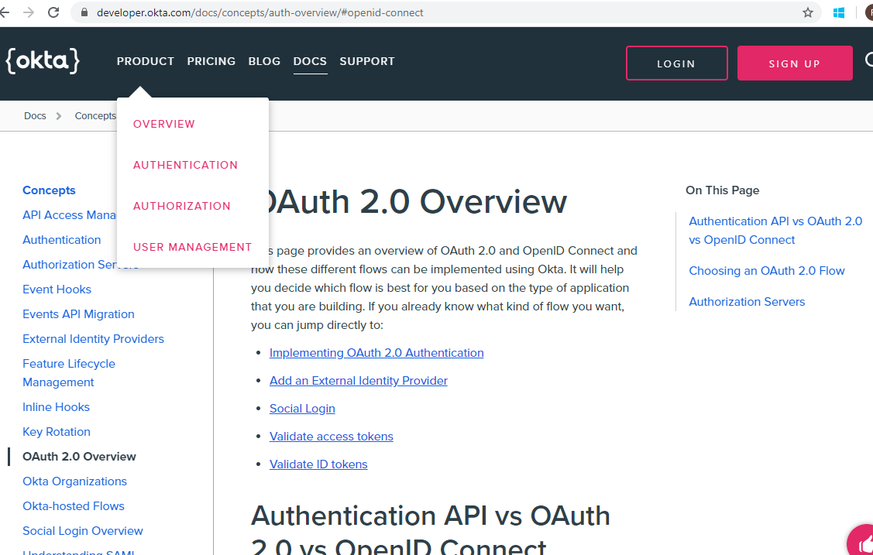
Cotiviti AEE CoP Identity Management
OKTA Development API Interfaces
OAuth / OIDC
SAML
SCIM

Slide 17
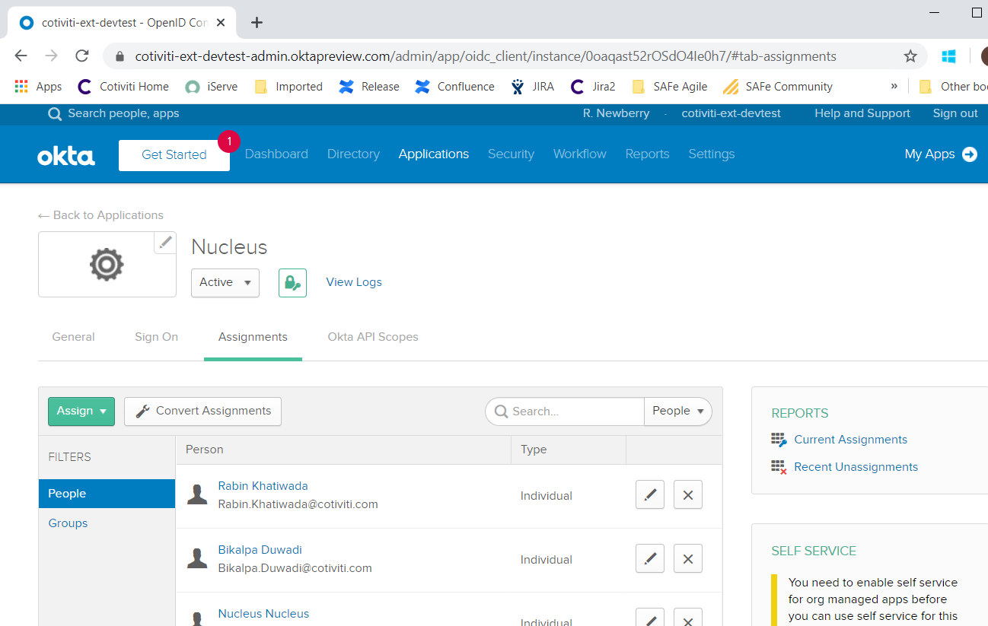
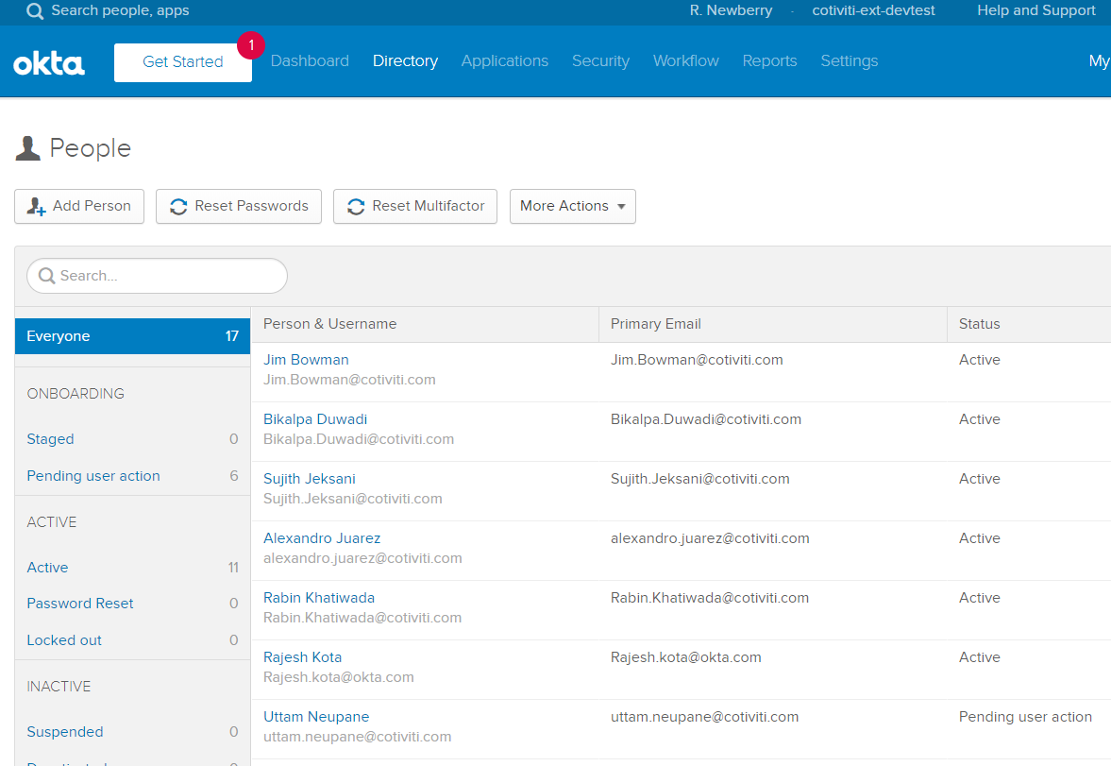
Cotiviti AEE CoP Identity Management
OKTA User Interface Overview

Slide 18
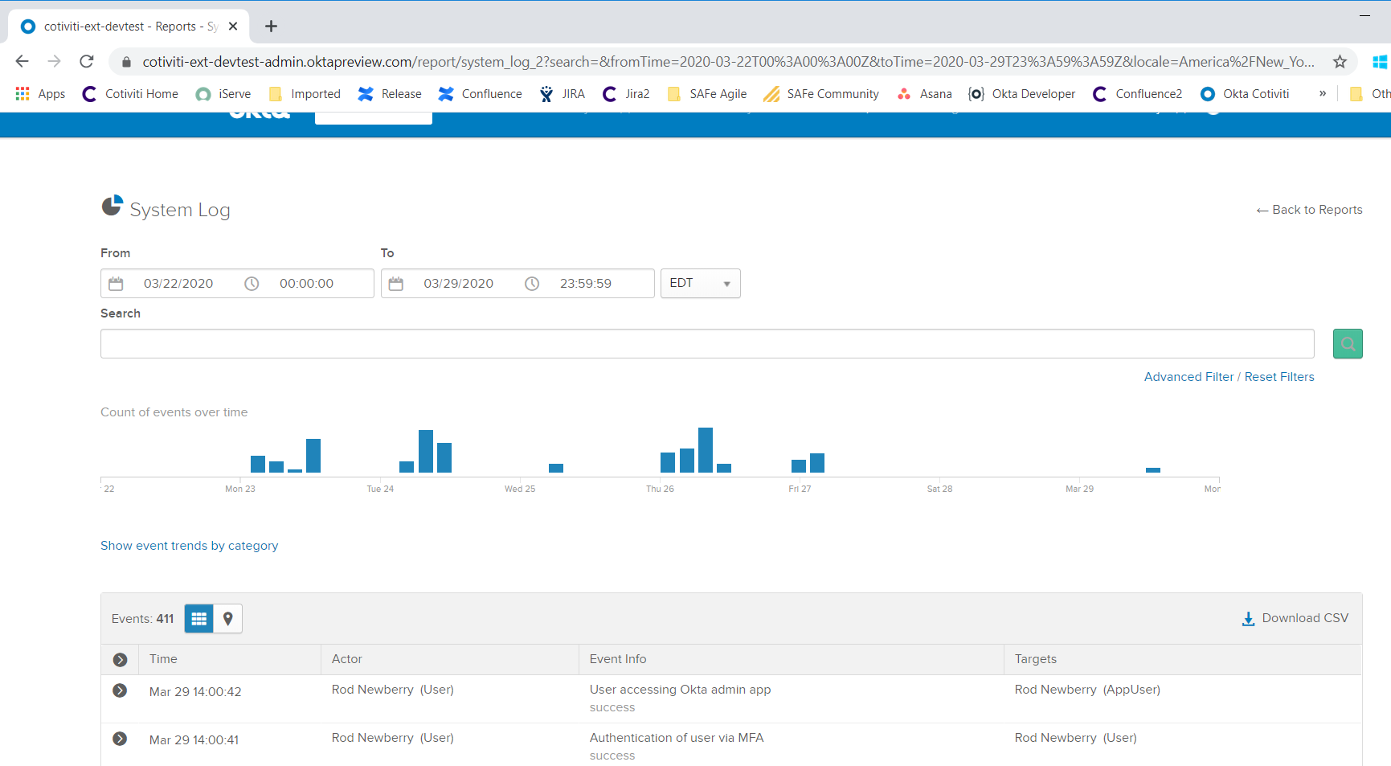
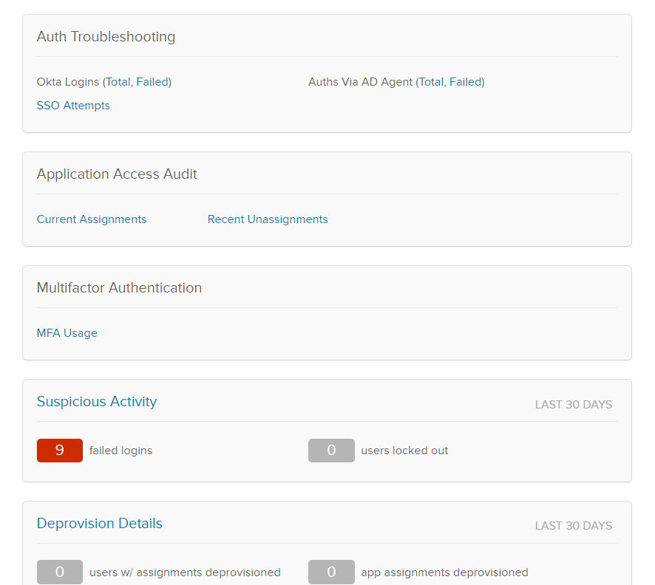
Cotiviti AEE CoP Identity Management
OKTA User Interface Overview System Utils

Slide 19
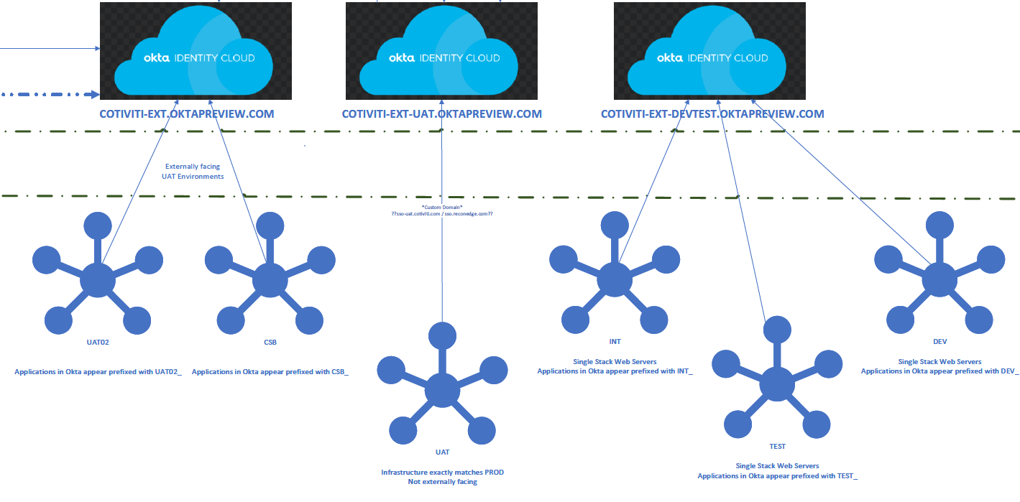
Cotiviti AEE CoP Identity Management
OKTA Cotiviti Environments
DEV Development Individual/Multi Use
DEVTEST Team Development and Test
UAT UAT
Client Facing Client Facing Test Enviornment
PROD Production

Slide 20
Cotiviti AEE CoP Identity Management
Progress To Date: Documentation / Confluence / Agile Architecture Roadmap

Slide 21
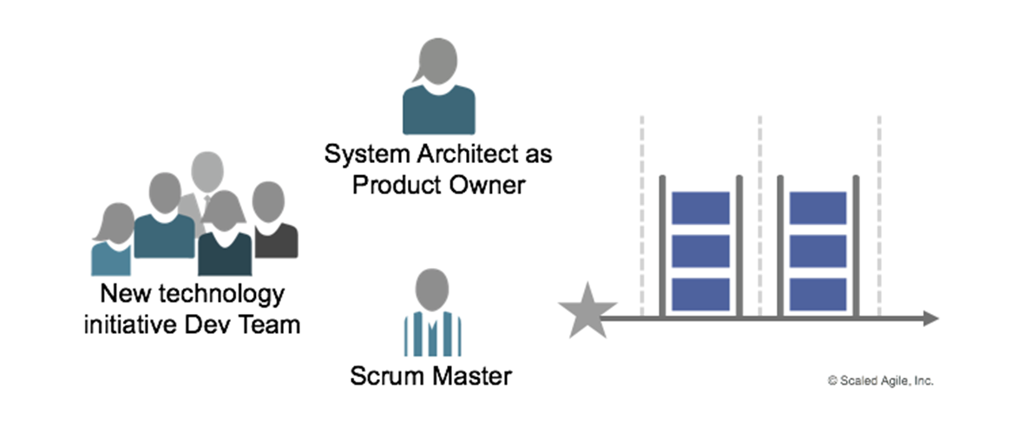
Architectural Runway
The Architectural Runway a key element of Agile Architecture's lean way of enabling and balancing between Emergent and Intentional Architecture:
The Architectural Runway … provides the necessary technical foundation for developing business initiatives and implementing new Features and/or Capabilities… consists of the existing code, components, and technical infrastructure needed to implement near-term features without excessive redesign and delay.
The Architecture Runway includes:
Architectural Vision, Published Standards, and Foundational Components.
These evolve over time as business goals and technology evolve.
AEE will act as the PO of the Architecture Runway, and we will work to build a foundation that support the Architectural Vision. This includes creating enablers to be completed by development teams (internal, contractors, or combination).
The Architectural Runway is a Product that is consumed by development teams.
It runs just like any other product team, although in this case the PO will likely be an Architect, and many of the enablers and features will be developed on other ARTs

Slide 22
JIRA: Architectural Runway Board
Jira Link:
https://jira2.cotiviti.com/secure/RapidBoard.jspa?rapidView=3147&projectKey=AR
Epic and Features:
AEE team created an Epic and list of Features as Enterprise level.
All these features defines functional, non-functional and infrastructure changes to implement integration with OKTA IM.
Respective application teams e.g. R&D, Risk, Nucleus and RMI teams needs to create application specific Features/user stories based on the requirement and link/map to respective Features defined in AR board.
AEE team will help app. teams to understand the Features. So that application teams can draft respective application Features by the help of their Product Owner.
Okta Initiative Epic and Feature details:
Overall feature and mapping details.
# EPIC | # Features | # Nucleus | # RPM
04 | 15 | 02 | 07

Slide 23
Confluence
Confluence is used as collaboration wiki tool to help teams to collaborate and share knowledge efficiently. Overall Okta SSO initiative update is captured in Confluence to track Project status, Progress, Timelines, Workshop/training status and Risk/issues details.
Confluence link:
https://confluence2.cotiviti.com/display/AEE/Single+Sign-on
Zoom Recording:
All workshop session recordings and meeting minutes are uploaded in Confluence.
OKTA Documents and best practices:
All okta shared design documents and best practices are uploaded in confluence.
Status reporting:
AEE team update weekly project update
Timelines
Environment
Feature status
Risk, Mitigation and Issues

Slide 24
Accomplishments
Topic | Status | Participants | Comment
OKTA Training | Completed | Okta PS and Cotiviti app teams
Risk Adjustment Integration workshop | Completed | Risk/RPM and Okta PS teams
Nucleus Integration workshop | Completed | Nucleus and Okta PS team
Okta Design document Review | Open | Okta and Cotiviti app teams
SAML 2.0 , SCIM Working session with okta | Open | Okta and Cotiviti app teams
Environment setup for QA/UAT testing | Completed
AEE-Okta PS meeting | On-going (Weekly)
Okta trainings | Completed | Cotiviti developers

Slide 25
Cotiviti AEE CoP Identity Management
Development Practices and Steps

Slide 26
OKTA Identity Management
Authentication - process of proving the identity of person or system.
Federation – process by which app request for proof of authentication from trusted source.
Federated Single Sign on – Combination of single authentication event and multiple requests for proof of authentication.
OIDC – Open Identity Connect
OIDC - Scope and Claims
SAML – Security Assertion Mark up Language

Slide 27
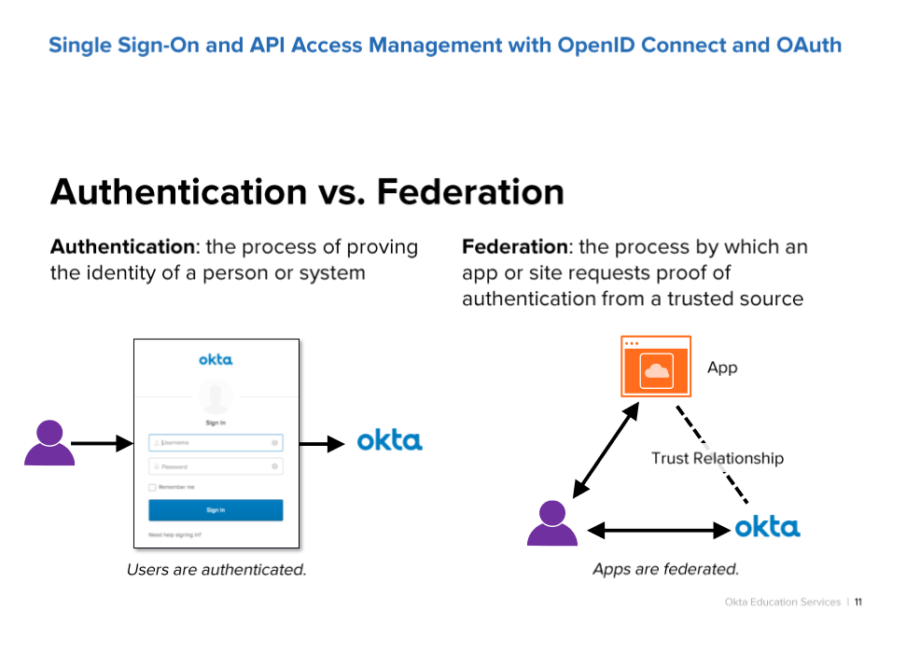

Slide 28
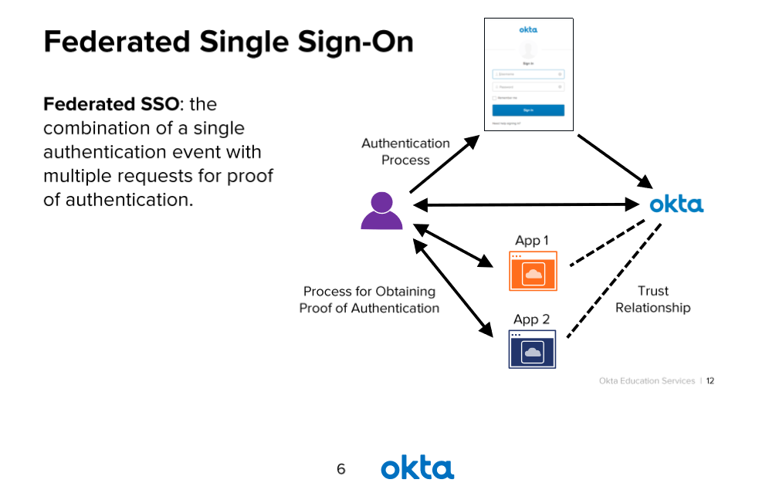

Slide 29
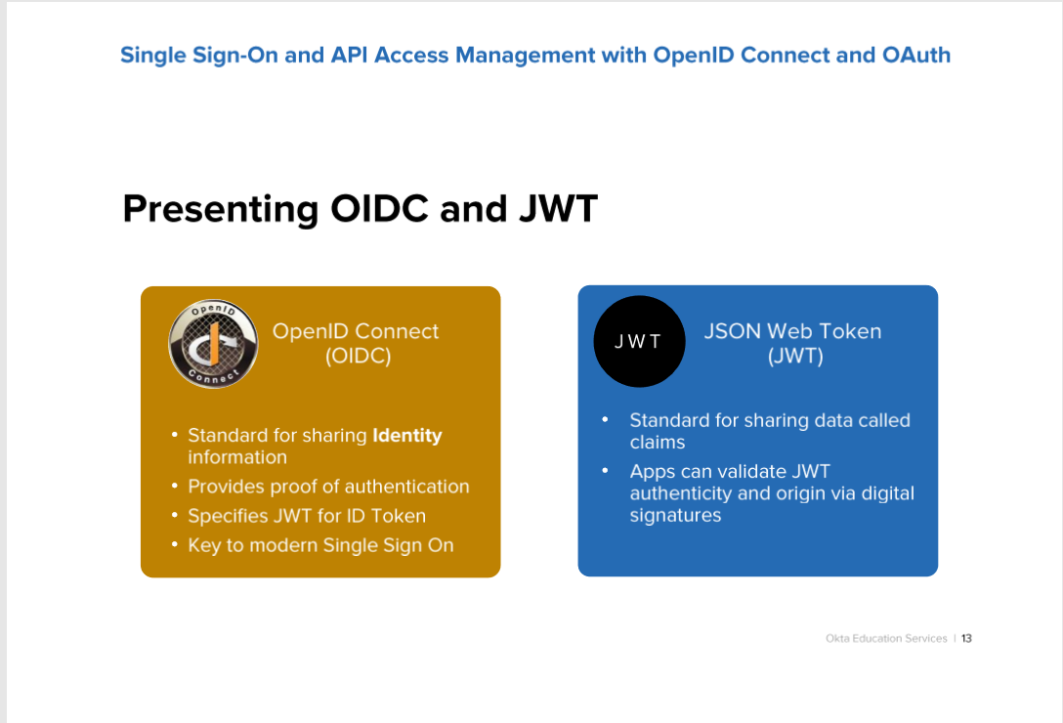

Slide 30
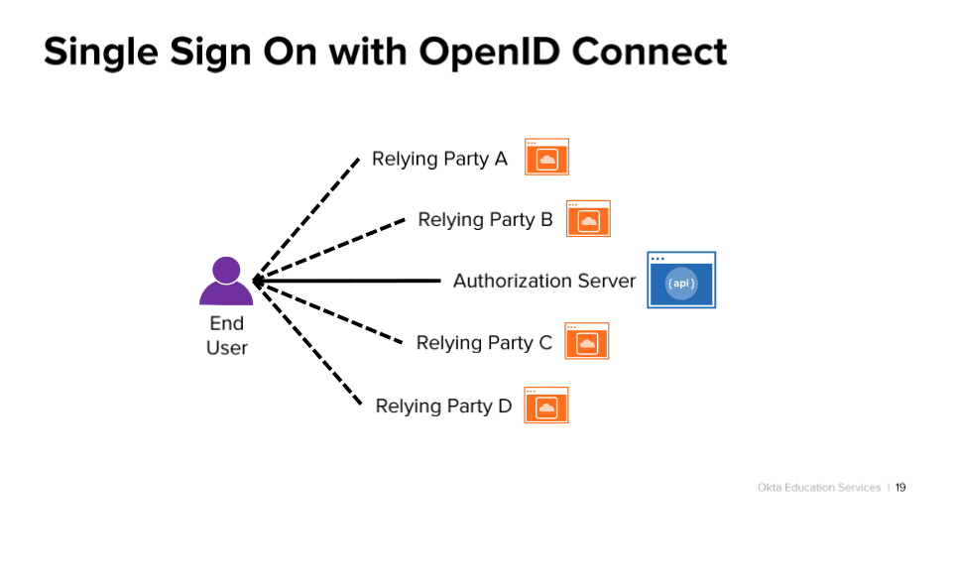

Slide 31
OKTA Identity Management
Steps for App set up with OIDC
Client ID
Client Credentials / or PKCE w/o Credentials
Issuer ID
Login redirect URL
Logout redirect URL
Default vs Customer Authentication Server

Slide 32
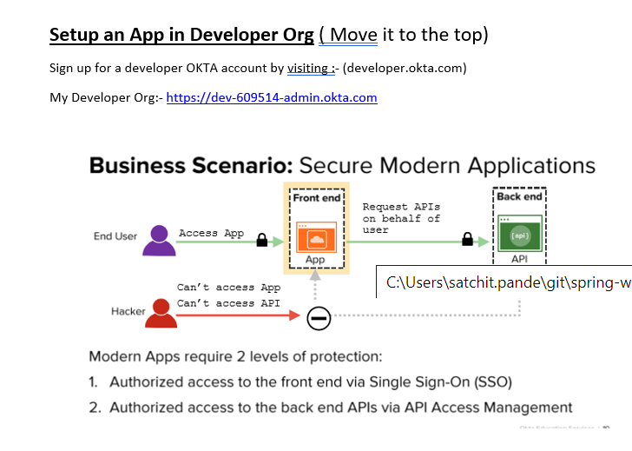

Slide 33
SPA app & REST service information
REST API Endpoint :- http://localhost:5000/publicpromos
SPA App URL :- http://localhost:8080/home
Client ID:- 0oa4z3np8BRJceVqf4x6
Issuer URI: https://dev-609514.okta.com/oauth2/default
Org URL : https://dev-609514.okta.com
SPA App hosted at http://localhost:8080/home would access both the public REST endpoints & private endpoints hosted by REST service -> http://localhost:5000/
SPA app provides the client ID to the Authorization server hosted at Issuer URI which in turn returns the ID Token to the SPA app (using authorization code as grant type).

Slide 34
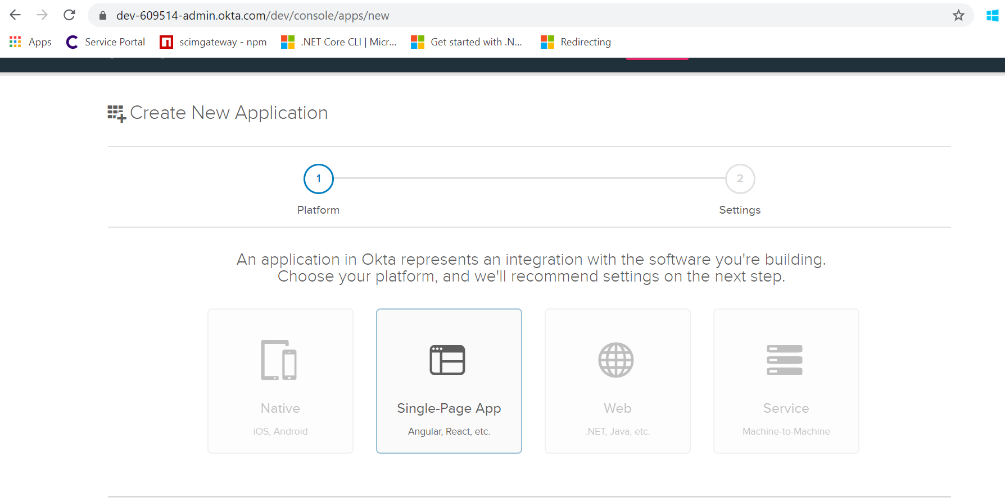
Create New App

Slide 35
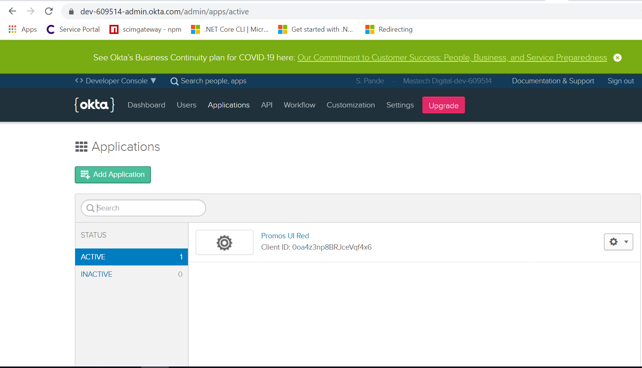
Add SPA application (client ID captured)

Slide 36
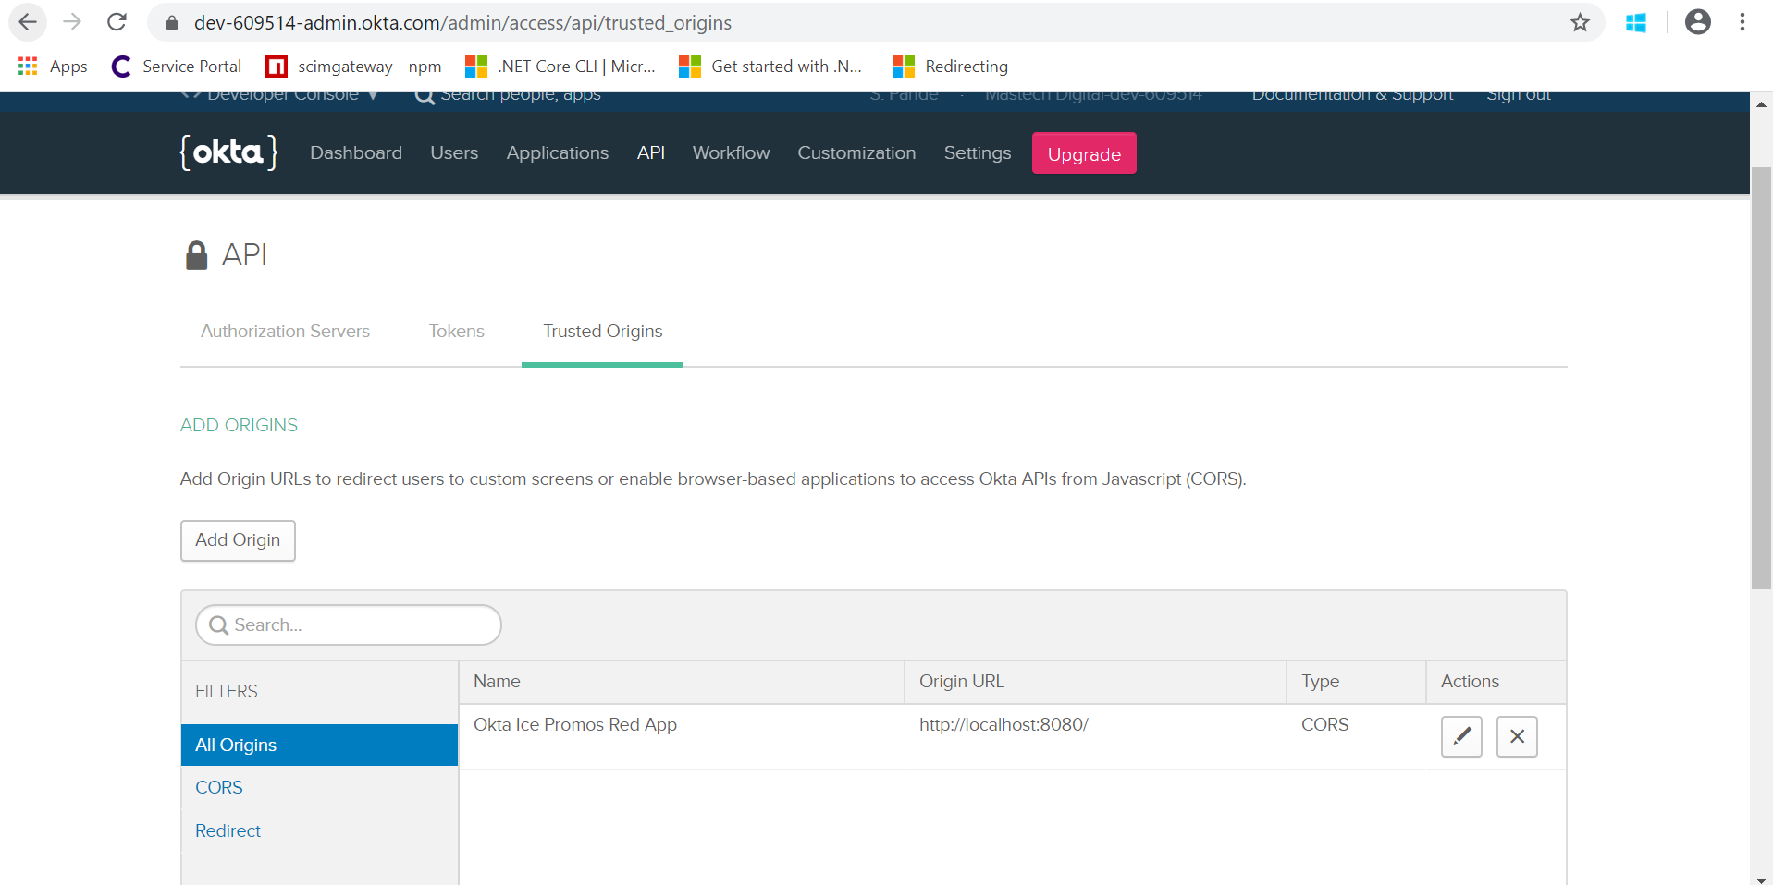
Trusted Origin

Slide 37
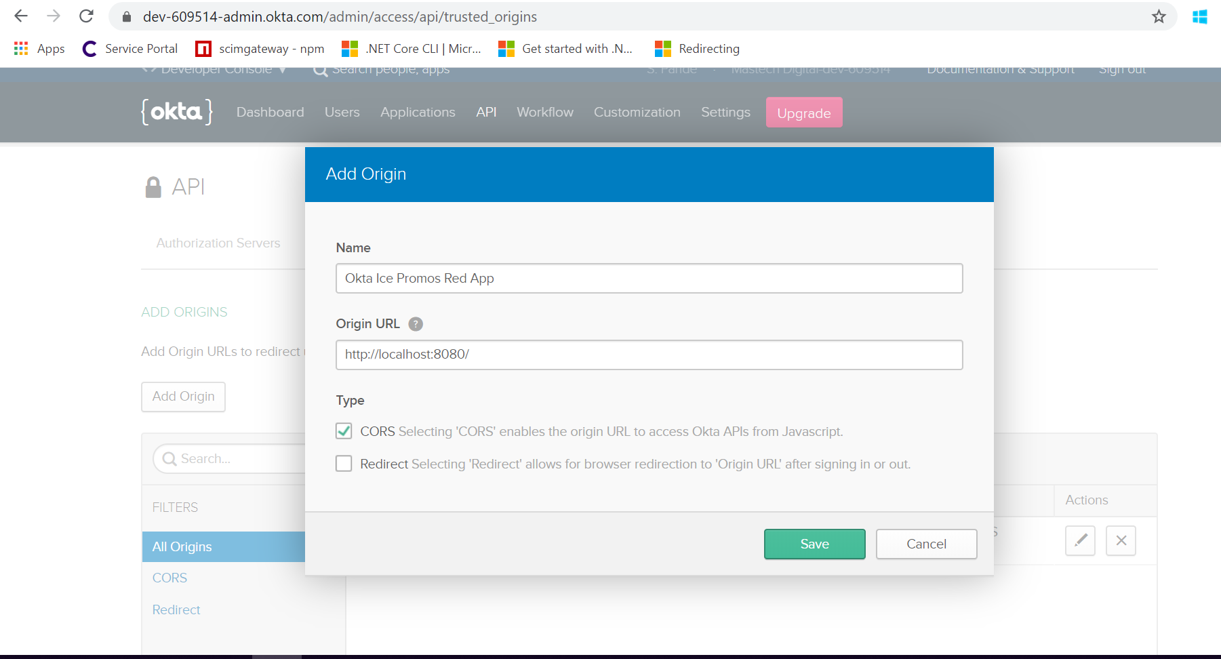
Enable CORS

Slide 38
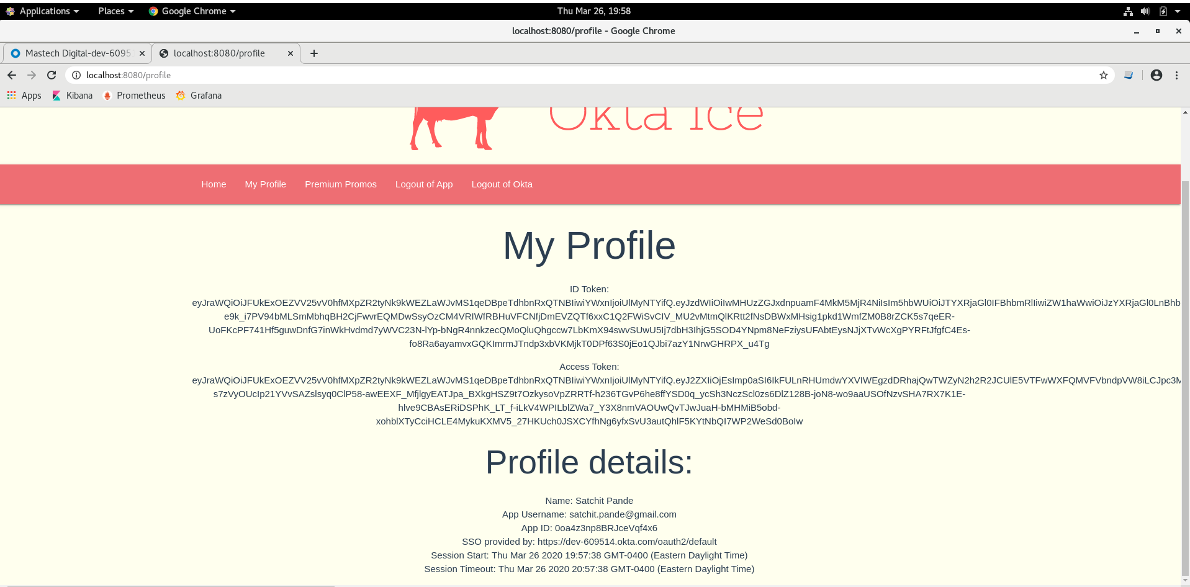
Profile endpoint (secured)

Slide 39
OKTA Identity Management
Next Steps
Custom Login page – Cotiviti Apps
SCIM 2.0 templates vs SCIM 2.0 Gateway
User Migration

Slide 40
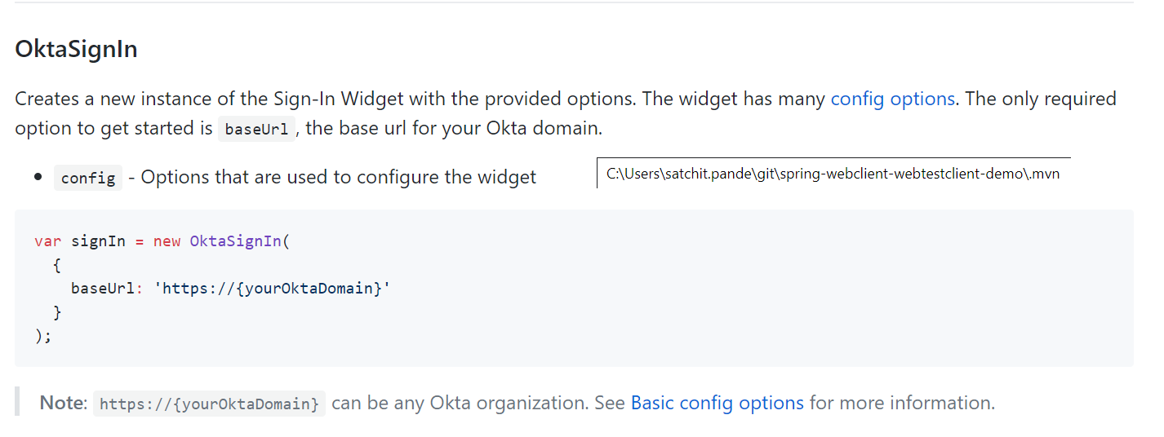
Custom Login Page (OKTA Sign-in Widget)
Installing the Okta, or by packaging it with your app via OKTA’s npm package, @okta/okta-signin-widget. ( Reference :- https://github.com/okta/okta-signin-widget#using-the-okta-cdn)
Using the Okta CDN
Loading OKTA assets directly from the CDN is a good choice if you want an easy way to get started with the widget, and don't already have an existing build process that leverages npm for external dependencies.
To use the CDN, include links to the JS and CSS files in your HTML:
<!-- Latest CDN production Javascript and CSS --><script src="https://global.oktacdn.com/okta-signin-widget/3.8.2/js/okta-sign-in.min.js" type="text/javascript"></script><link href="https://global.oktacdn.com/okta-signin-widget/3.8.2/css/okta-sign-in.min.css" type="text/css" rel="stylesheet"/>

Slide 41
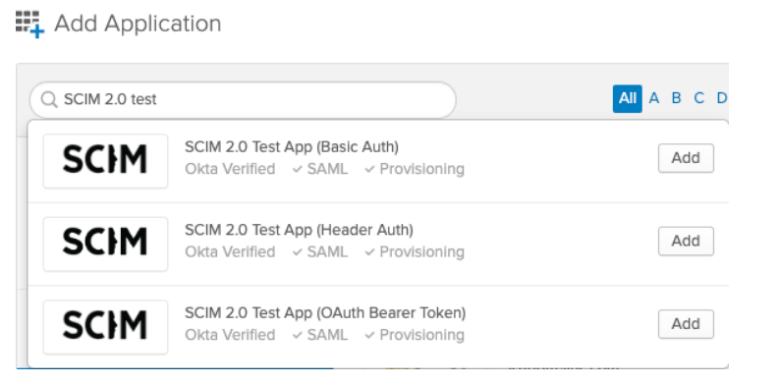
SCIM
SCIM (System for Cross Domain Identity Mapping) specification is an open standard designed to manage user identity information. SCIM provides a defined schema for representing users and groups, and a RESTful API to run CRUD operations on those user and group resources.
Reference:- https://developer.okta.com/docs/concepts/scim/

Slide 42
Cotiviti AEE CoP Identity Management
OKTA Appendix

Slide 43
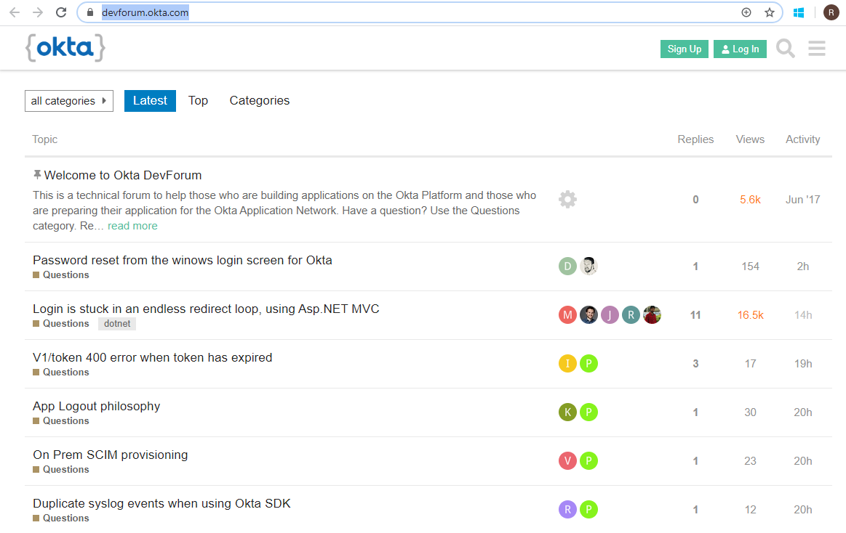

Cotiviti AEE CoP Identity Management
OKTA Reference
OKTA Development Forum / BLOG
https://devforum.okta.com/
OKTANE Online Conference - Many Sessions Available to Stream
April 1st – 2nd 9am-5pm Pacific Time
https://www.oktane20.com/

Slide 44
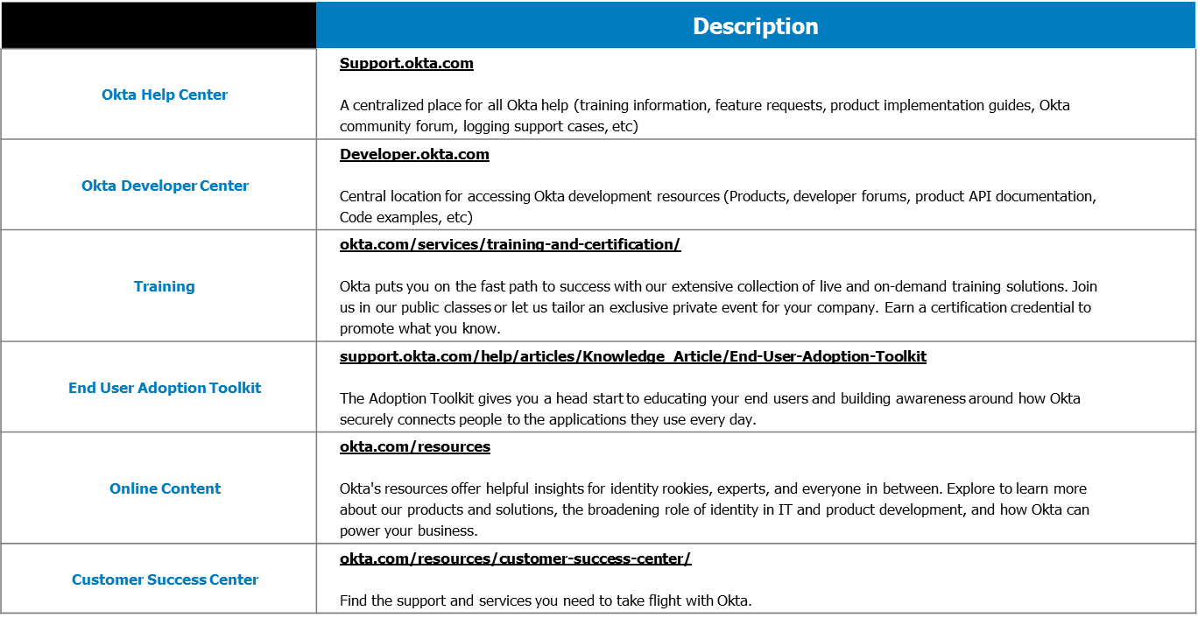
Cotiviti AEE CoP Identity Management
OKTA Reference

Slide 45
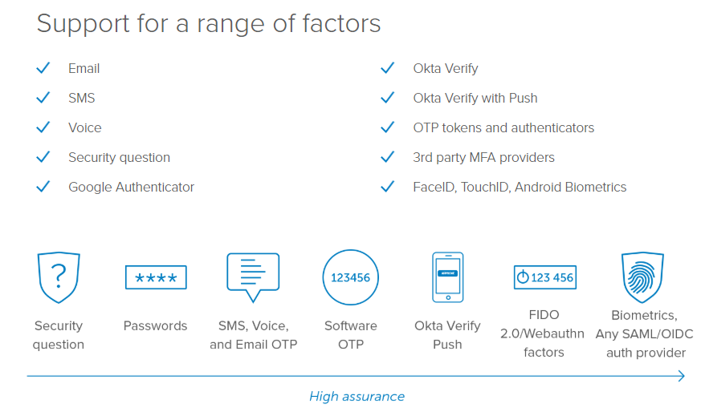
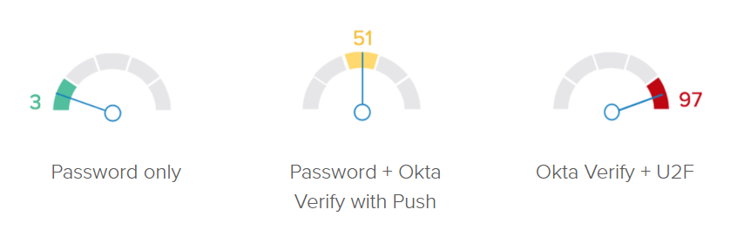
Cotiviti AEE CoP Identity Management
OKTA Reference MFA
OKTA MFA Options are extensive.
Cotiviti Applications to evaluate needs, add what is needed. Or None.
OKTA Verify MFA is required for all Admin accesses to OKTA environments
Contextual MFA Policies

Slide 46





Thousands of Customers
Health
Consumer
Technology
Finance
Ed, Gov, Non-Profit
Manufacturing, Energy
Services
Media
Cloud

Slide 47
Reference Information

Slide 48
Architectural Runway
https://www.scaledagileframework.com/agile-architecture/
The Architectural Runway a key element of Agile Architecture's lean way of enabling and balancing between Emergent and Intentional Architecture:
The Architectural Runway … provides the necessary technical foundation for developing business initiatives and implementing new Features and/or Capabilities… consists of the existing code, components, and technical infrastructure needed to implement near-term features without excessive redesign and delay.
The Architecture Runway includes:
Architectural Vision, Published Standards, and Foundational Components.
These evolve over time as business goals and technology evolve.
AEE will act as the PO of the Architecture Runway, and we will work to build a foundation that support the Architectural Vision. This includes creating enablers to be completed by development teams (internal, contractors, or combination).
The Architectural Runway is a Product that is consumed by development teams.
It runs just like any other product team, although in this case the PO will likely be an Architect, and many of the enablers and features will be developed on other ARTs

Slide 49
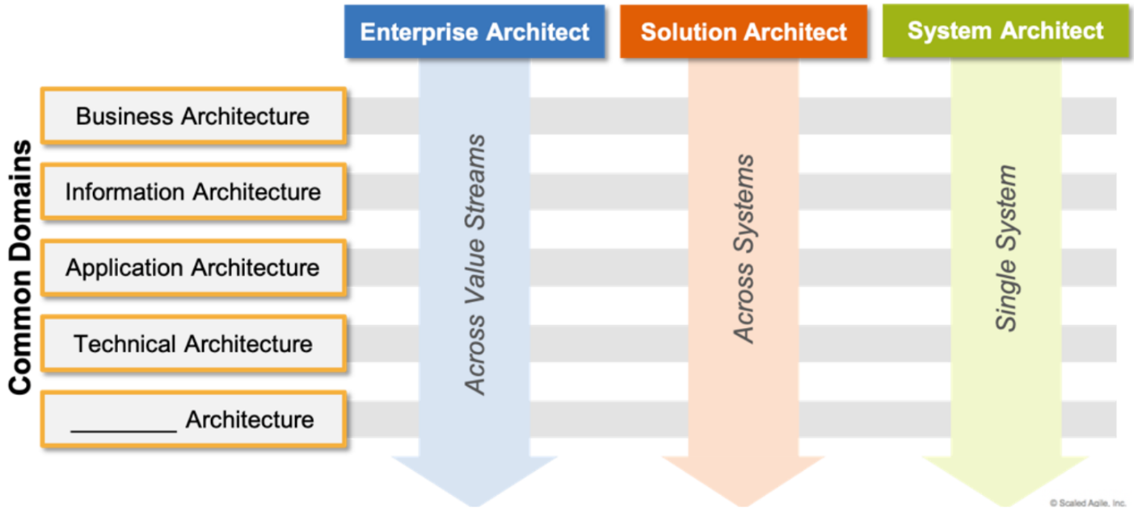
Engagement with R&D teams (and other teams) SAFe Architecture Roles
https://www.scaledagileframework.com/agile-architecture/
AEE Architects will fulfill the SAFe framework’s architecture roles in varying ways:
Enterprise Architect
SAFe Definition:
This person works across value streams/programs to help provide the strategic technical direction that can optimize portfolio outcomes. The enterprise architect often may act as an epic owner for enabler epics.
Our Initial Plan:
AEE Architects fulfill this role (resources TBD).
AEE Architects will be assigned to each BU or Portfolio and be engaged with all associated planning activities.
Engagement with BU/Portfolio ensures Enterprise Architects have the broad context required to support the business, and optimize the use of technology across the organization
When presented with a lean business case, Architects will coordinate T-shirt sized estimates for planning, each with a list of assumptions, inclusions, exclusions, caveats, and a confidence rating. (Enterprise Architects will collaborate with teams to ensure estimates are appropriate!)

Slide 50

Engagement with R&D teams (and other teams) SAFe Architecture Roles
System Architect
SAFE Definition:
An individual or small cross-discipline team that truly applies systems thinking. They define the overall architecture of the system, help define nonfunctional requirements, determine the major elements and subsystems, and help define the interfaces and collaborations among them.
Our Initial Plan:
For large projects, an Enterprise architect may spend significant time with a team, however, the imbedded Architects will carry the bulk of the weight, leaning on Enterprise Architects for guidance.
Imbedded Architects vary in maturity, so their expanded role and involvement with the AEE organization may have an initial Impact on their productivity.
Solution Architect
SAFE Definition:
Responsible for defining and communicating a shared technical and architectural vision across multiple ARTs to help ensure the system or Solution under development is fit for its intended purpose.
Initial Plan:
Enterprise Architects will often personally fulfill this need, but as often they will work with imbedded Architects to complete all the required architectural activities/tasks.
This collaboration will help identify and groom future Enterprise Architects.

Slide 51
Engagement with R&D teams (and other teams) Ceremonies and Practices
Enterprise Architects will participate and be present at each of the following:
Portfolio Sync - As part of the strategic planning performed in the portfolio meetings, the AEE architect (Typically an Enterprise Architect) will help translate business themes into potential solutions.
PI Planning - Enterprise Architects will participate in the more tactical PI Planning process, combining business features with features and enablers required to achieve business goal in alignment with the Architecture Runway.
PO Sync - This ceremony will allow Architects to be alerted of potential issues and intervene, as necessary. Enterprise Architects may delegate attendance to Solution/System Architects.
Architects may participate in other ceremonies as necessary (ex. Retrospectives)
Collaboration is critical as our organization continues to evolve.
R&D COPs/COEs (Dev Ops, Workflow, etc.)
Infrastructure Architects in IX
Data Architects in Sumant's Data Warehouse/Lake team
Sales and Marketing
And more….

Slide 52
Current Enterprise Architect Assignments Agile Release Trains, RT Engineers, and Associated Architects
We will try to maintain a single AEE point-of-contact for each RT.
Typically it will be a Senior Architect, but it will be delegated at times.
RTs | RTEs | Enterprise Architect
RCA | Michelle Goida Murielle Ballard | Mike Josh
RMS & CCV | Mio Ballard Raghu Tammina (Offshore) | Mike
PCA: Parser, RE, Client Interfaces PCA: Policy Mgmt. & related Tools | Luanna Sutton Raghu Tammina (Offshore) | Amit
PCA to CV, CPE, CVP | Scott Phipps | Amit
Coding/Submissions/FWA | Victor Galli | Rod
Quality & Performance Analytics | None | Rod

Slide 53
Activities Specific activities driven by the AEE
Below are some of the larger projects the Enterprise Architects are driving.
Initiative | Impacted RTs (Impacts to date) | Enterprise Architect
SSO (Okta) | CV/Nucleus, Quality, ECL | Rod
Data Ingestion/Datalake (Nile/Caspian) | All | Mike
Callable Rules | PCA, CPE, CVP, RCA | Amit/Mike
Prepay Expert Review Applications | CV, PrePay RCA | Mike
CAT rewrite | RMS & CCV | Rod
Logging (ELK Stack) | CV/Nucleus | Amit
Containerization | Callable Rules | Amit

Slide 54
Services Specific services the AEE team provides
These are some of the services that can be requested of the AEE.
and more…
Service
Estimates | Enterprise Architects are called upon to do initial high-level estimates (usually Epic level) to facilitate Portfolio planning. These are T-Shirt size estimates that give the portfolio team a sense of the size of a project that when combined with the value projected for that work, allows them to do strategic planning.
RFP Responses | Enterprise Architects will be participating in RFP Responses when required. Involvement TBD.
Guidance and Mentoring | Each of the Enterprise Architects will mentor architects imbedded in the teams. We expect embedded architects to act as promoters of the Architecture Runway within their area, helping to ensure adherence, untilazation, and uncover new needs. Team embedded architects may be called on to participate in many of these various AEE activities, including solution architecture, research, or guiding others.
Dissemination of information | At times, the AEE will sponsor presentations to disseminate information. These may be formal or non-formal (ex. Lunch and Learns) and may be presented by an AEE member, a technology leader in the R&D organization, or just about anyone. We will eventually make the cadence more formal but initially these will be scheduled when appropriate.
Research | Complete periodic research on industry news, trends, and innovations (ex. Blockchain, Augmented Reality)

